Slide 1

Clock Hierarchy, Power-on and Reset

Slide 2
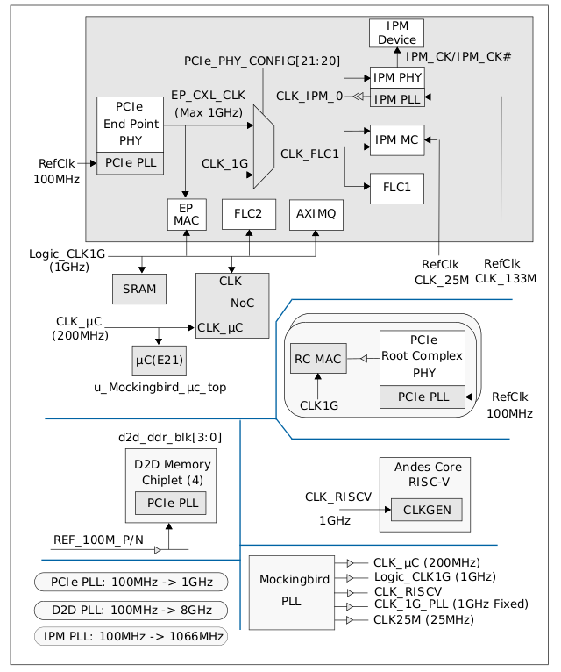
Clock Hierarchy

Slide 3
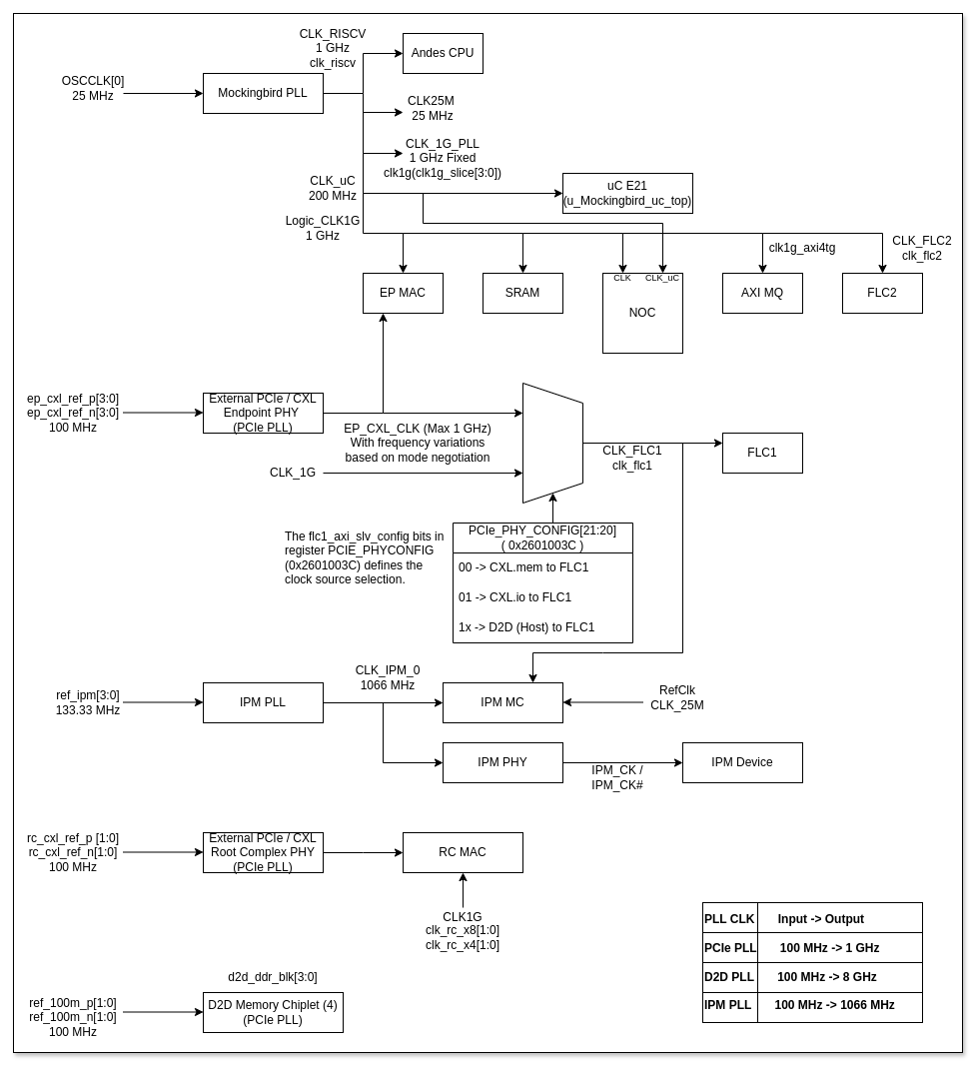
Clock Hierarchy

Slide 4
Verification and Debugging of Clocks
MKB_PLL_CTRL1 (0x26000100) contains pll_en bit (bit 0) which must be set to 1 to enable the PLL
MKB_PLL_CTRL2 (0x26000104) configures the reference clock divider and feedback clock divider
MKB_PLL_CTRL3 (0x26000108) contains fractional value of feedback divider for fractional mode operation and bit-wise post divide enable
PLL_LOCKED Output Signal - This output signal indicates that the SoC PLL is locked and its generated clocks are ready for use. This status can be read from the MKB_PLL_CTRL1 (0x26000100) specifically bit 30
CB_nPOR (Power-on Reset) and CB_nRST (Global Chip Reset) are critical for ensuring a clean reset of the PLL and clock circuitry, along with entire chip
The flc1_axi_slv_config bits in register PCIe_PHYCONFIG [21:20] (0x2601003C) defines the clock source selection for FLC slices
AXI4TG_CTRL (0x26000418) has axitg_err (bit 17) and axitg_irq (bit 16) which could indicate issues related to clock or functionality
Check D2D PLL status registers D2D_DDRx_pll_sts (0x26000710 - 0x2600071C) for GFHx_D2D_PLL_LOCKED status, and MKB_D2D_PLL_sts (0x26000720) register for MKB_D2Dx_PLL_LOCKED. The uC also trains inter-D2D timing during initialisation
The IPM PHY is initialised by the E21. The ipm_mcu_core_rstn bit (bit 0 in register 0x26000064) is asserted to enable the PHY’s MCU
The PMU_CTRL (0x26000004) has a uC_hclk_halt_en bit (bit 0) which can stop uc HCLK when in WFI state; this should be considered during debugging power states, when set to 1 enables the stopping of the uC’s HCLK (AHB CLK)
Check EMAC_MIIMODE register for CLKDIV field, which sets the Management Data Clock for PHY management

Slide 5
Power-Up Timeline and Register Programming
Power Applied - System clocks became stable
E21 Boot - The SiFive E21 RISC-V core begins booting. The uC first fetches D2D and I3C initialization code from internal ROM
PHY Firmware Download - Firmware from IPM, PCIe, DDR and D2D PHYs is downloaded
PHY Initialization - The PHYs (IPM, PCIe, DDR, D2D) are initialized. For IPM PHYs, the E21 loads FW via the APB bus, then asserts ipm_mcu_core_rstn (bit 0 in register 0x26000064) to enable the PHYs MCU
PHY Output Clock Stable - Output clocks from IPM, D2D and PCIe PHYs stabilize
I3C, D2D Link Layer Synchronization - The I3C and D2D interfaces synchronize, The uC programs D2D and I3C, making I3C ready. Then it trains inter-D2D timing I3C, making D2D ready
Functional Unit Initialization - PCIe MAC, IPM, DDR Memory Controllers and FLC are initialized. The uC fetches initialisation code from Serial Flash and performs FLC, PCIe and IPM initialisation. For other chiplets, it executes system initialization code via D2D, using I3C for interrupt messages
RISC-V System Bring Up -
uBoot and OS images are downloaded from the host (via PCIe) to DDR or on-die SRAM or RISC-V code can be downloaded from QSPI SF
The Embedded Trace Macrocell / Embedded Trace Module (ETM) is brought up
The E21 sets up the reset vector in CSR registers 0x26000014 (SYSCTRL_RISCV) and 0x26000018 (SYSCTRL_RISCV_RSTVEC). For example, 0x26000018 can be written with 0x000C0000 (reset vector base), and 0x26000014 with 0x00085001 (reset vector offset and release core 0 reset). The E21 releases the RISC-V core from reset
Once initialized, normal I/O (UART, Ethernet) and DMA data paths are enabled

Slide 6
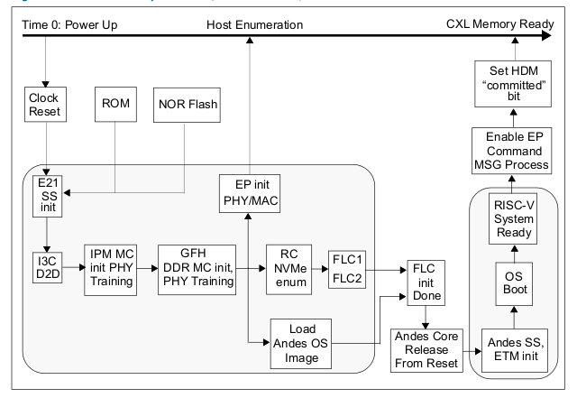
Power-Up Timeline and Register Programming

Slide 7
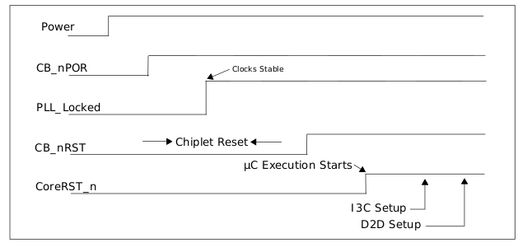
System level Reset and Power-Up Sequence
In CXL.mem mode -
CB_nPOR -> Active low, Power-on reset signal that resets the PLL and clock circuitry (Pin for Power-On Reset)
CB_nRST -> Active low, Global chip reset (Pin for Global Chip Reset)
CoreRST_n -> Active low, resets the embedded uC (Pin for CPU subsystem Reset or Core Reset)
An external reset chip is required to detect stable voltage levels and manage reset timing
The PLL_LOCKED output signal indicates when the SoC PLL is locked and the clock is ready

Slide 8
IP Specific Power-Up and Reset
Mockingbird Chiplet -
IO Power (VDD_IO_1V8) - 1.8V +/- 10%
Core Power (VDD_CORE) - 0.8V +/- 10%
SOC PLL Analog Supply (pll_vddhv) - 1.8V +/- 10%
SOC PLL Digital Supply (pll_vddpost, pll_vddref) - 0.8V +/- 10%
D2D PLL Analog Supply (hs_pll_vddhv) - 1.8V +/- 10%
D2D PLL Digital Supply (hs_pll_vddpost, hs_pll_vddref) - 0.8V +/- 10%
D2D PHY VDDQ Supply (d2d_vddq_s) - 0.3V / 0.5V / 0.825V
D2D PHY VDDCLK Supply (d2d_vddclk_s) - 0.8V +/- 10%
D2D PHY VDDA Supply (d2d_vdda_s) - 1.2V +/- 10%
OTP Power (otp_vdd) - 0.8V
Additional OTP Power (otp_vdd2) - 1.8V +/- 10%
Temperature Sensor Analog Supply (VDDA_TS) - 1.8V +/- 10%
Voltage Monitor Analog Supply (VDDA_VS) - 1.8V +/- 10%
The voltages are typically supplied by Power Management ICs on the validation board, which convert 12V to various lower voltages (example; 3.3V, 1.8V, 1.2V, 0.8V, 0.3V). An external reset chip is required on the board to detect stable voltage levels and manage the overall reset timing.
CB_nRST has an internal pull-up, so no external pull-up resistors are explicitly provided in the source for the primary global reset lines from the FPGA to the chiplet. The 0.1uF capacitor (C160) associated with RESET_GF_AND_MKB which likely provided a small delay of 10us between the CB_nPOR, CB_nRST and CoreRST_n signals

Slide 9
IP Specific Power-Up and Reset
IPM MC and IPM PHY -
The IPM PHY requires ipm_vdd2 (1.1V IO / PLL power) and ipm_vddq (0.3V IO power), these are provided as IPM_MEM_VDD2 (1.1V@10A) and IPM_VDDQ_VDD (0.3V@5A) by PMICs
The IPM MC is a part (an internal block) of the chiplet, drawing power from the internal power rails (core supplies)
force_clk_ipm_en (bit 19) in PMU_CTRL (0x26000004) to 1 can disable clock gating for IPM, ensuring their clocks are always active
The uC (E21) is responsible for initializing the IPM PHY and MC
Initial power-up of IPM PHY - VDD = 1, PHY.boot_i = 1, PHY.mcu_core_rstn = 0, MC.clk_resetn = 0
The ipm_mcu_core_rstn bit (bit 0) in the IPM_PYHCONFIG (0x26000064) register to 1 to is programmed by the E21 to release the IPM PHY’s core from reset
A 0.5ms wait is observed for PHY training.
PHY.boot_i = 0 and MC.clk_resetn = 1 (by programming bit 5 of IPM_PHYCONFIG to 0)
The E21 then performs MC Control and Status Registers initialisation

Slide 10
IP Specific Power-Up and Reset
FLC1 and FLC2 -
FLC initialization is a post-PHY boot-step
The FLC_SLICE_RST[3:0] bits (bits 31:28) in the PMU_CTRL (0x26000004) register can apply a hardware reset to the FLC PCIe slices. These bits allow the uC to control the reset of specific FLC slices
force_clk_ipm_en (bit 19) , force_clk_flc1_en (bit 20) and force_clk_flc2_en (bit 21) in PMU_CTRL (0x26000004) to 1 can disable clock gating for IPM, FLC1 and FLC2 respectively, ensuring their clocks are always active
PMU_CTRL (Power Management Unit Control) (0x26000004) Register -
Bits [8:11] - Control the reset state of D2D_DDR interfaces for the Goldfinch chiplets. 0 places the interface in a reset state, while 1 enables it.
Bits [12:15] - Control the pull-up enable for the Serial Flash I/O pins
Bits [16:17] - Control the reset state of the Mockingbird’s own D2D interfaces. 0 puts the interface in reset, and 1 enables it

Slide 11
IP Specific Power-Up and Reset
EMAC -
The EMAC is part of the “Functional unit init” stage in the overall boot sequence. The E21 uC interacts with the EMAC via its AHB master interface
The E21 uC configures the PHY via the EMAC’s MDIO interface
A dedicated reset pin for the Ethernet PHY, ETH_MII_nRST, is present on the board
SiFive E21 RISC-V Core -
The core power is 0.8V typically from VDD_CORE
The dedicated CoreRST_n pin is used to reset the embedded uC. Its release from reset triggers the start of uC execution. The uC’s boot procedure involves setting the reset vector in CSR (0x26000014 to 0x2600001c) and then releasing the RISC-V reset

Slide 12
IP Specific Power-Up and Reset
GPIO -
GPIO pins are powered by the chiplets IO voltage rails, primarily VDD_IO_1V8
Registers like GPIO_CFG_CTRL0 (0x20005100) to GPIO_CFG_CTRL9 (0x20005124) contain reg_gpio_x_pu and reg_gpio_x_pd bits to control the pull-up or pull-down controls
SF-NOR -
Flash memory requires 1.8V VDD_IO. The sf_clk output provided the serial flash clock
4.7K resistors and 0.1uF capacitors are associated with the QSPI Flash connections
AXI4TG -
AXI4TG_CTRL (0x26000418) contains and axi4tg_resetn (bit 0) which is an active-low reset for AXI bus

Slide 13
THANK YOU

